Slide 1

A Day in the Life of a Member
How Your Mobile App Can Make or Break Engagement

Slide 2
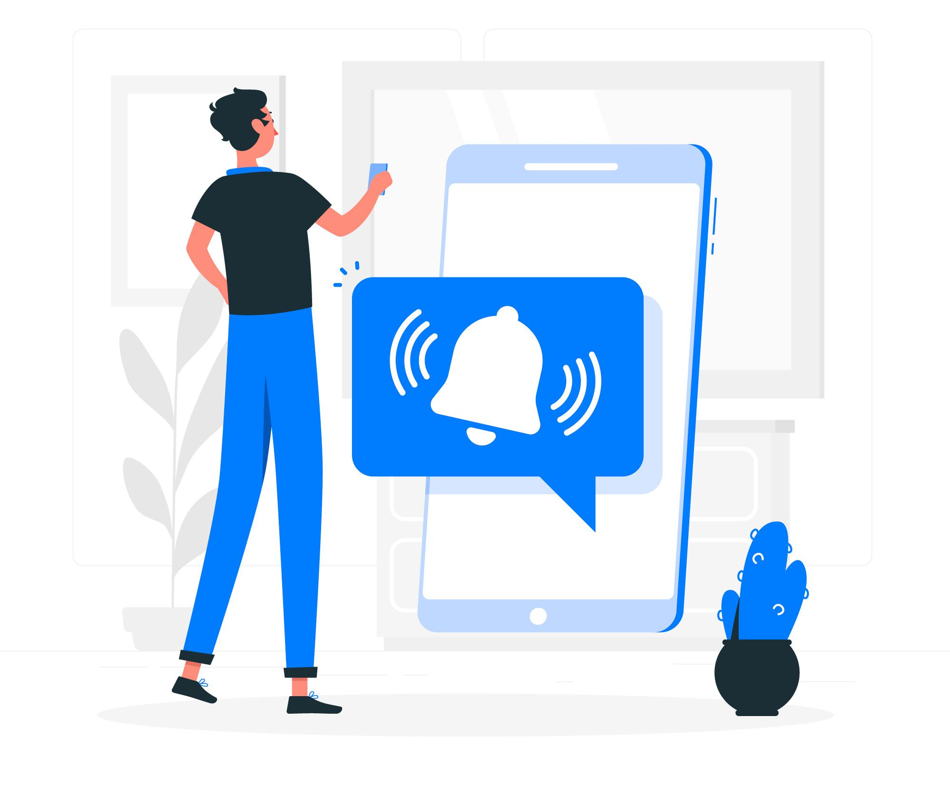

Morning: The Information Seeker
Your member wakes up, checks their phone, and misses an important update because it was buried in an email.
Instead: A push notification delivers the key update right on their home screen.

Slide 3
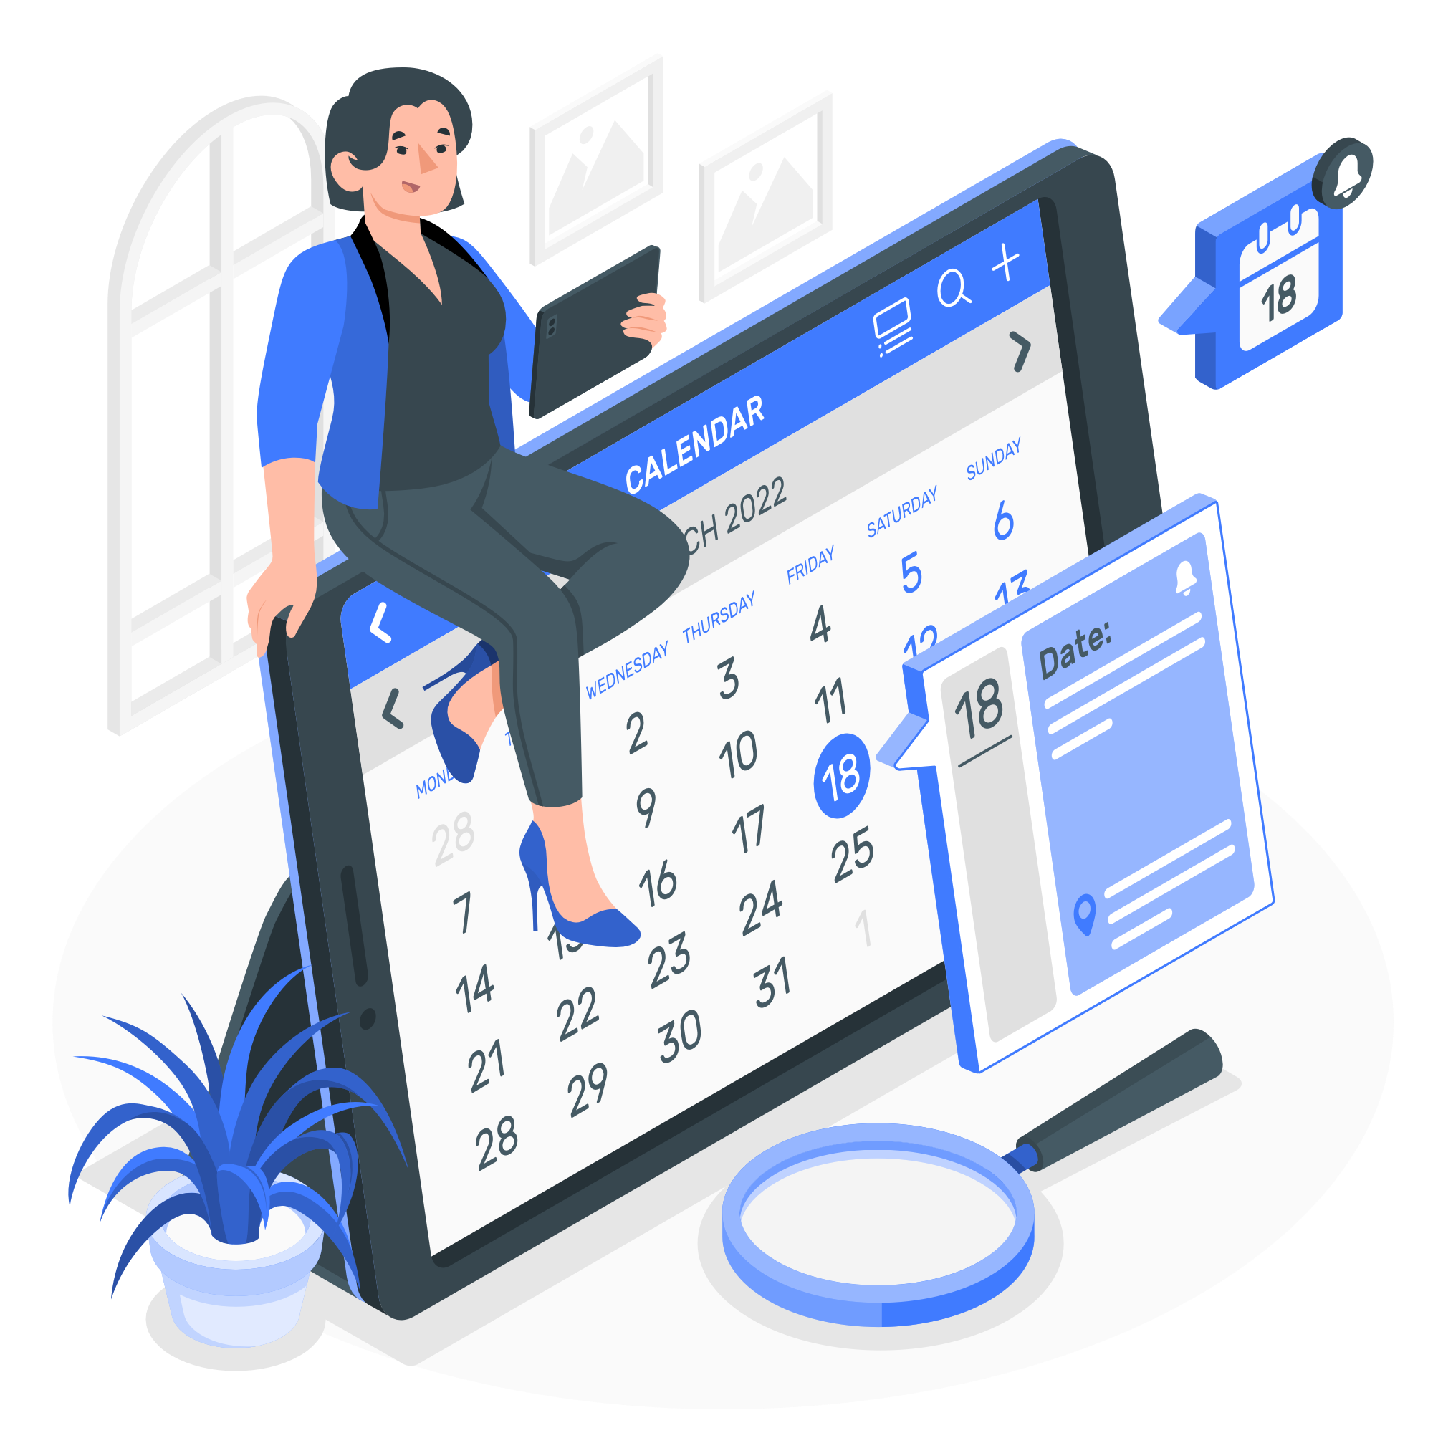
Midday: The Event Explorer
They want to attend an upcoming event but get lost in a maze of links.
Instead: A well-designed content hub inside the app highlights events, lets them easily find session and booth locations, and offers the ability to add sessions and functions to their calendar.

Slide 4
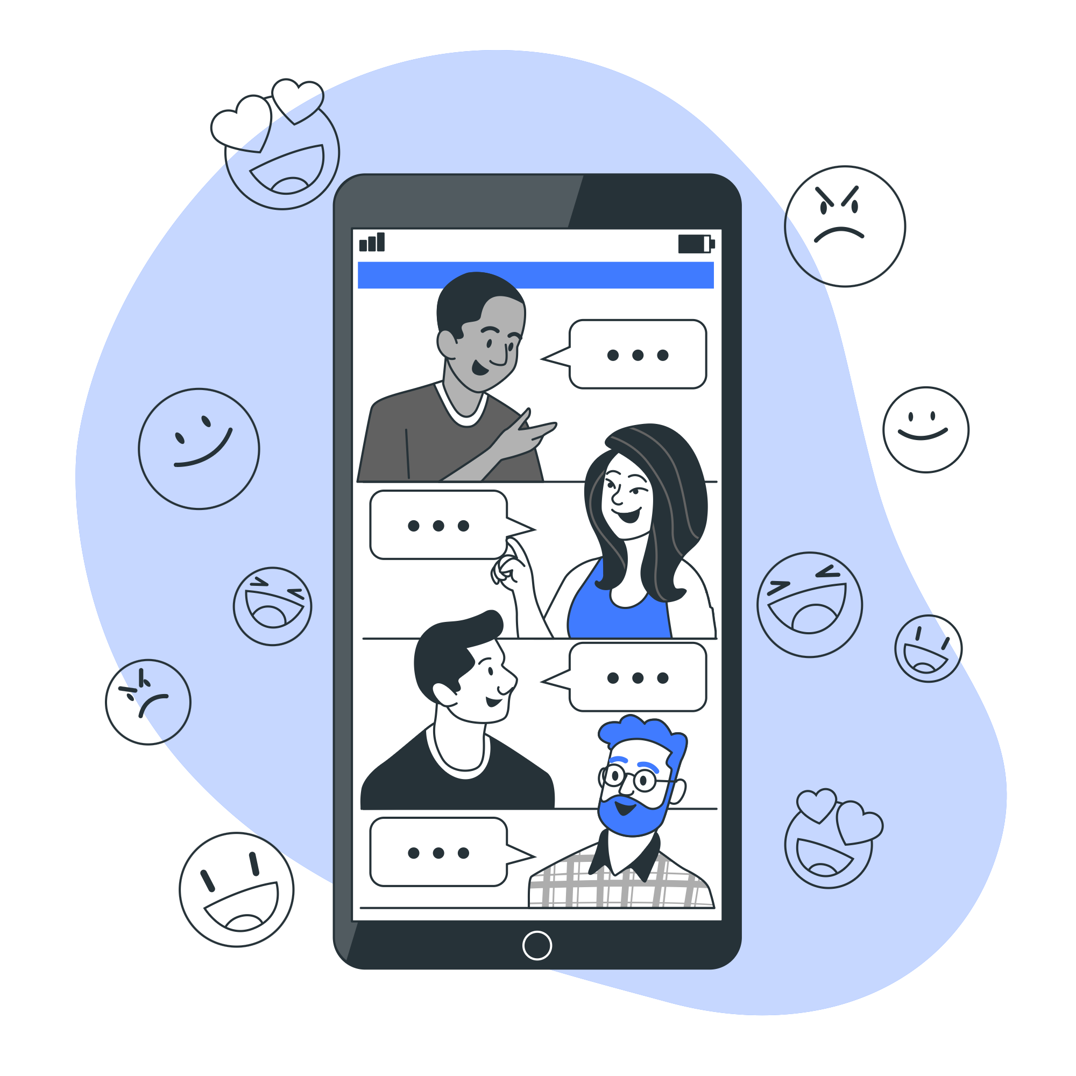
Afternoon: The Networker
They try to connect with peers but struggle with email chains.
Instead: In-app messaging and discussion forums make networking effortless, keeping conversations in one place.

Slide 5
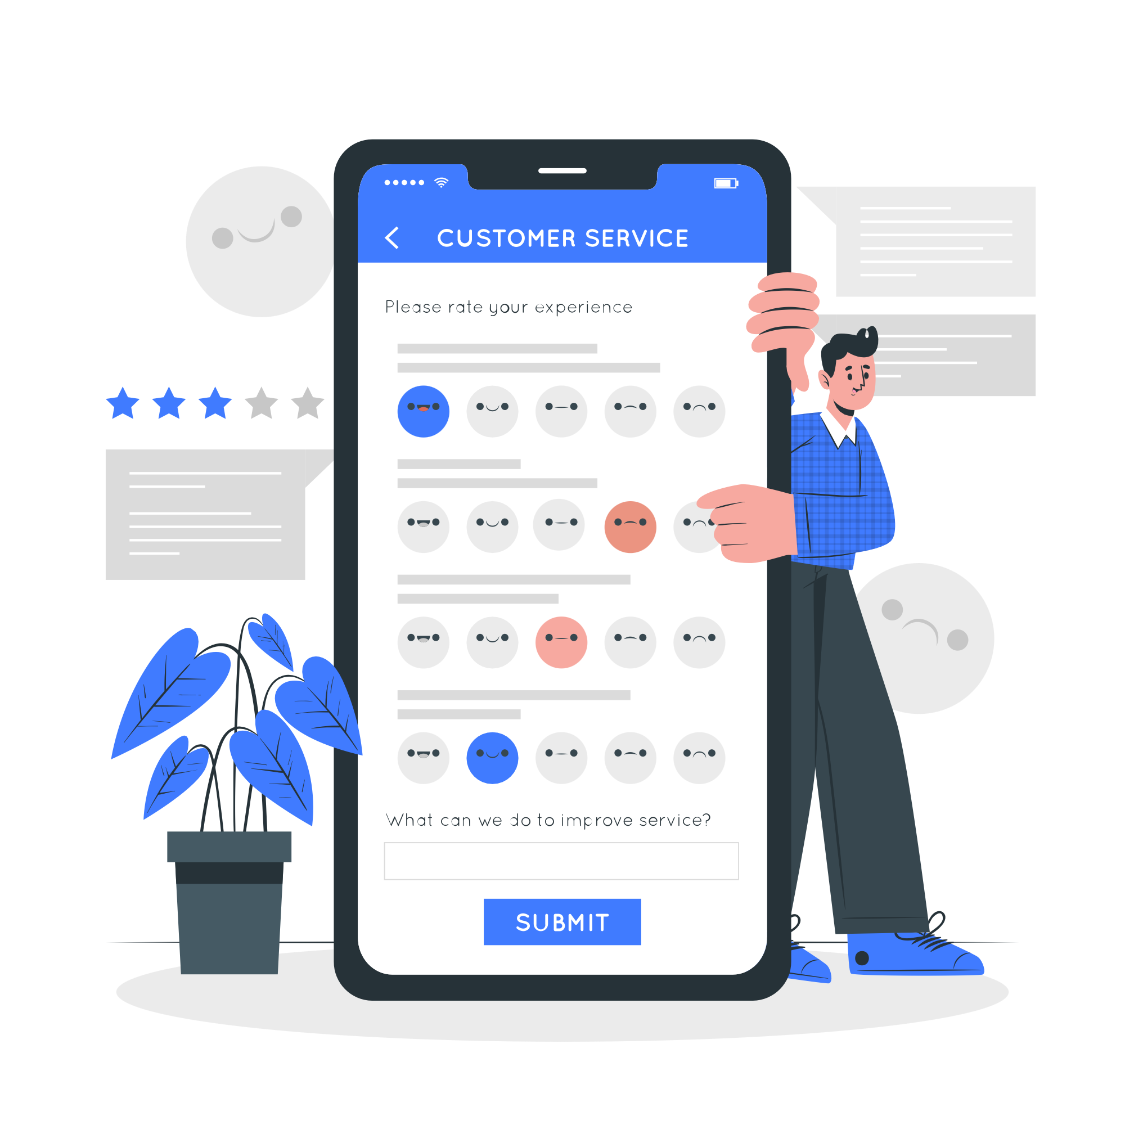
Evening: The Feedback Giver
They want to share feedback but don’t have time for a long survey.
Instead: A quick poll in the app captures their immediate feedback or lets them vote on future topics in seconds.

Slide 6
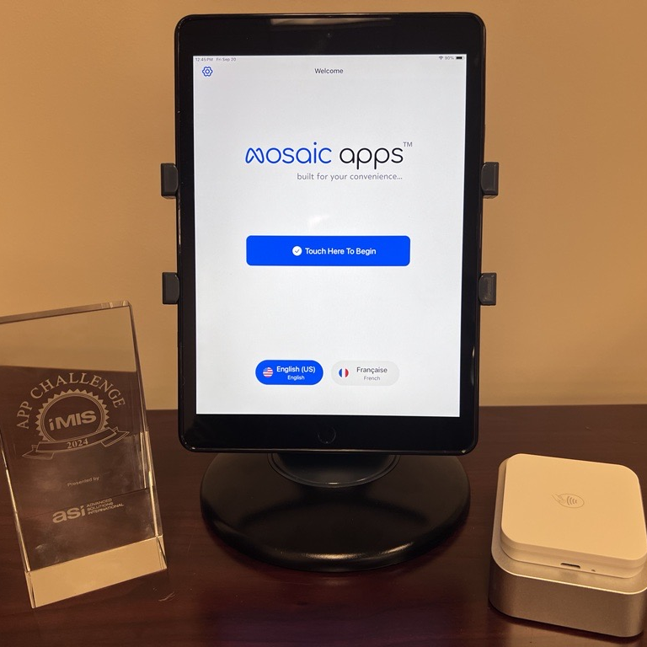
Final Takeaway
A mobile app isn’t just a tool—it’s a member’s daily companion. When designed right, it becomes the ultimate engagement driver.
Would you like to enhance your member communication strategy? Discover how mosaic apps™ can help.

Slide 7
Contact Us We’re here to help and answer any questions you might have. We look forward to connecting with you.
+1 (703) 936-5919
https://www.mosaic-apps.com/
info@mosaic-apps.com

